Slide 1
Social Position in Networks

Slide 2
Social position in networks
In standard social science social position is measured either:
  As a rank on some kind of ordinal or continuous scale
    Wealth, income, education
  As membership in some kind of nominal category
    Gender, race, marital status
  Standard social science measures social position as attribute similarity
    Two actors occupy the same social position is they have the same rank on scale (e.g., college educated) or are members of the same nominal category (e.g., gender)

Slide 3
Social position in networks
In standard social science social position is measured either:
  As a rank on some kind of ordinal or continuous scale
    Wealth, income, education
  As membership in some kind of nominal category
    Gender, race, marital status
  Standard social science measures social position as attribute similarity
    Two actors occupy the same social position is they have the same rank on scale (e.g., college educated) or are members of the same nominal category (e.g., gender)
In social network analysis social position is measured by the pattern of relations each actor has with other actors in the network
  Social network analysis measures social position as relational similarity

Slide 4

Social position in networks
Positional analysis is the branch of social network analysis in charge of:
  Defining different notions of network position
    Using graph theory
  Developing techniques to measure them:
    Using matrix algebra
The position of actor b in the network is given by their pattern of relations to other actors
  How similar (or different) in terms of their connectivity pattern is b from other actors?
  Can we create groups or classes of actors based on their relational similarity?
Directed Graph
 | a | b | c | d | e
a | -- | 1 | 0 | 0 | 0
b | 1 | -- | 0 | 0 | 0
c | 0 | 1 | -- | 1 | 1
d | 0 | 0 | 0 | -- | 0
e | 0 | 0 | 1 | 1 | --

Slide 5
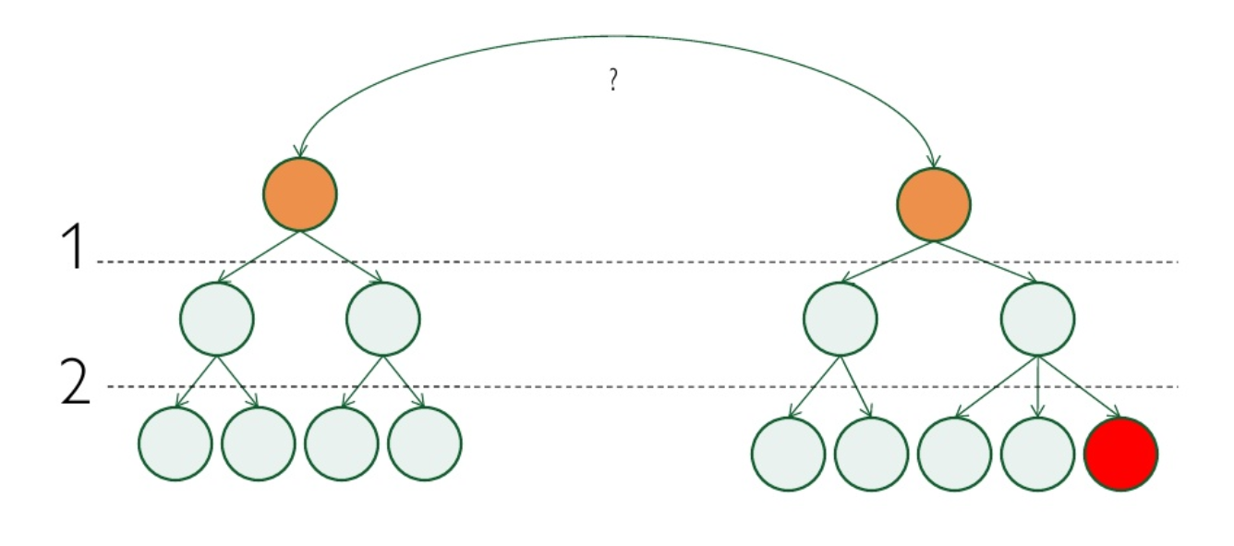
Differences between positional and clique analysis
Positional analysis is both similar and different from cohesive subgroup (clique) analysis:
  Both partition the original set of actors (nodes) into subsets (subgraphs). But
    In cohesive subgroup analysis the aim is to find clusters of actors that are strongly connected to one another
    In positional analysis the aim is to find a cluster of actors who have the same pattern of connections to other actors

Slide 6
Differences between positional and clique analysis
Positional analysis is both similar and different from cohesive subgroup (clique) analysis:
  Both partition the original set of actors (nodes) into subsets (subgraphs). But
    Actors in the same position in a network don’t need to be directly connected to one another!
      Although they could
    Actors in the same subgroup need to be directly or indirectly connected to one another

Slide 7



Notions of Equivalence: Structural Equivalence
Structural equivalence is the simplest of the equivalence notions in positional analysis
  Two nodes u and v are structurally equivalent if they are connected to the same others
  If N(a) is the set of vertices vertex is connected to (a’s neighborhood)
  If N(b) is the set of vertices vertex b is connected to (b’s neighborhood)
    Then a and b are structurally equivalent if N(a) = N(b)
      Without counting a or b!

Slide 8
Notions of Equivalence: Structural Equivalence
Structurally equivalent actors:
  Have the same ego-networks (they are connected to the same set of others)
  Are part of the same 2-clique (they are connected by at least a path of length 2)
  Have the same graph theoretic attributes (e.g., centrality, clustering coefficient, etc.)
    But not necessarily the reverse!
      Two actors can have the same graph theoretic attributes but not be connected to the same others

Slide 9
Notions of Equivalence: Structural Equivalence
Kin and hierarchical relations provide the basic model of structural equivalence
  Parents are structural equivalent (in relation to offspring)
  Siblings are structurally equivalent (in relation to parents)
  In work settings people at the same level of the hierarchy are structurally equivalent
Parent
Parent
Supervisor
Supervisor
Son
Daughter
Worker
Worker

Slide 10
Notions of Equivalence: Structural Equivalence
A positional analysis finds a set of positions P = {l, m, n…}
  Where each position (blocks) is a subset of equivalent nodes in the original network
    The symbol for equivalence is ≣
      X ≣ Y reads as “X is (structurally) equivalent to Y”
a
b
g
h
e
f
c
d
i
j
Borgatti and Everett’s
“Thinking Graph”

Slide 11
Notions of Equivalence: Structural Equivalence
A positional analysis finds a set of positions P = {l, m, n…}
  Where each position (blocks) is a subset of the nodes in the original network that are seen as equivalent
  In the case of positions defined as structural equivalence below:
    P = {a ≣ c}, {b ≣ d}, {e ≣ e}, {f ≣ f}, {g ≣ i}, {h ≣ j}
a
b
g
h
e
f
c
d
i
j
Borgatti and Everett’s
“Thinking Graph”
Borgatti and Everett’s
“Thinking Graph”

Slide 12
Notions of Equivalence: Structural Equivalence
A positional analysis finds a set of positions P = {l, m, n…}
  Where each position (blocks) is a subset of the nodes in the original network that are seen as equivalent
  In the case of positions defined as structural equivalence below:
    P = {a ≣ c}, {b ≣ d}, {e ≣ e}, {f ≣ f}, {g ≣ i}, {h ≣ j}
a
b
g
h
e
f
c
d
i
j
Borgatti and Everett’s
“Thinking Graph”
Borgatti and Everett’s
“Thinking Graph”

Slide 13
Notions of Equivalence: Structural Equivalence
Structurally equivalent actors:
  Have the same ego-networks (they are connected to the same set of others)
  Are part of the same 2-clique (they are connected by at least a path of length 2)
  Have the same graph theoretic attributes (e.g., centrality, clustering coefficient, etc.)
a
b
g
h
e
f
c
d
i
j
Borgatti and Everett’s
“Thinking Graph”

Slide 14
Blockmodeling based on structural equivalence
Structural Equivalence Blocked Matrix
 | a | c | h | j | b | d | g | i | e | f
a | -- | 1 | 0 | 0 | 1 | 1 | 0 | 0 | 0 | 0
c | 1 | -- | 0 | 0 | 1 | 1 | 0 | 0 | 0 | 0
h | 0 | 0 | -- | 1 | 0 | 0 | 1 | 1 | 0 | 0
j | 0 | 0 | 1 | -- | 0 | 0 | 1 | 1 | 0 | 0
b | 1 | 1 | 0 | 0 | -- | 0 | 0 | 0 | 1 | 0
d | 1 | 1 | 0 | 0 | 0 | -- | 0 | 0 | 1 | 0
g | 0 | 0 | 1 | 1 | 0 | 0 | -- | 0 | 0 | 1
i | 0 | 0 | 1 | 1 | 0 | 0 | 0 | -- | 0 | 1
e | 0 | 0 | 0 | 0 | 1 | 1 | 0 | 0 | -- | 1
f | 0 | 0 | 0 | 0 | 0 | 0 | 1 | 1 | 1 | --
The off-block cells have the same values for each block!
a
b
g
h
e
f
c
d
i
j
People assigned to the same block are connected to the same others!

Slide 15
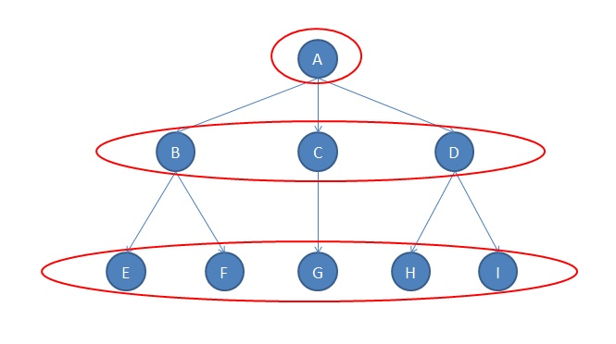
Notions of Equivalence: Regular Equivalence
Intuition:
  Two people are regularly equivalent if they are friends with the similar set of people
  Two papers are regularly equivalent if they cite a similar set of other papers
  Two species are regularly equivalent if they feed on similar set of prey
  Two clubs are regularly equivalent if they share similar set of members
  Two countries are regularly equivalent if they trade with a similar set of countries
Where similarity is graph theoretic similarity!

Slide 16
Notions of Equivalence: Regular Equivalence
Theoretically, the notion of role implies similar patterns of connectivity to similarly positioned actors not to literally the same actors
  Structural equivalence is the wrong measure in this case
    Need a more flexible notion of equivalence: Regular equivalence
a
b
g
h
e
f
c
d
i
j
Borgatti and Everett’s
“Thinking Graph”

Slide 17
Notions of Equivalence: Regular Equivalence
Theoretically, the notion of role implies similar patterns of connectivity to similarly positioned actors not to literally the same actors
  Structural equivalence is the wrong measure in this case
    Need a more flexible notion of equivalence: Regular equivalence
    P = {a ≣ b ≣ h ≣ j}, {b ≣ d ≣ g ≣ i}, {e ≣ f}
a
b
g
h
e
f
c
d
i
j
Borgatti and Everett’s
“Thinking Graph”

Slide 18
Notions of Equivalence: Regular Equivalence
Theoretically, the notion of role implies similar patterns of connectivity to similarly positioned actors not to literally the same actors
  Structural equivalence is the wrong measure in this case
    Two nodes are regularly equivalent if they are connected to equivalent others
    P = {a ≣ b ≣ h ≣ j}, {b ≣ d ≣ g ≣ i}, {e ≣ f}
a
b
g
h
e
f
c
d
i
j
Borgatti and Everett’s
“Thinking Graph”

Slide 19
Notions of Equivalence: Regular Equivalence
If two actors are regularly equivalent they have the same graph theoretic attributes, and vice versa:
  If two actors share all graph theoretic attributes they are regularly equivalent
  Regular equivalence is a non-local concept
a
b
g
h
e
f
c
d
i
j
Borgatti and Everett’s
“Thinking Graph”

Slide 20
Blockmodeling based on regular equivalence
Regular Equivalence Blocked Matrix
 | a | c | h | j | b | d | g | i | e | f
a | -- | 1 | 0 | 0 | 1 | 1 | 0 | 0 | 0 | 0
c | 1 | -- | 0 | 0 | 1 | 1 | 0 | 0 | 0 | 0
h | 0 | 0 | -- | 1 | 0 | 0 | 1 | 1 | 0 | 0
j | 0 | 0 | 1 | -- | 0 | 0 | 1 | 1 | 0 | 0
b | 1 | 1 | 0 | 0 | -- | 0 | 0 | 0 | 1 | 0
d | 1 | 1 | 0 | 0 | 0 | -- | 0 | 0 | 1 | 0
g | 0 | 0 | 1 | 1 | 0 | 0 | -- | 0 | 0 | 1
i | 0 | 0 | 1 | 1 | 0 | 0 | 0 | -- | 0 | 1
e | 0 | 0 | 0 | 0 | 1 | 1 | 0 | 0 | -- | 1
f | 0 | 0 | 0 | 0 | 0 | 0 | 1 | 1 | 1 | --
a
b
g
h
e
f
c
d
i
j

Slide 21
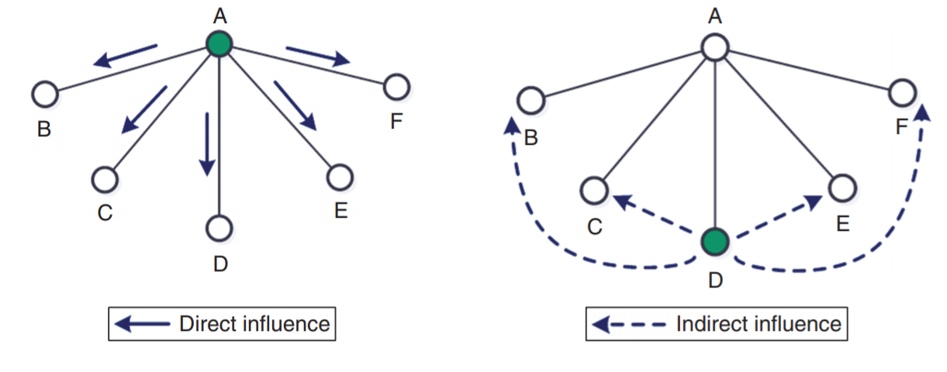
Positional equivalence model
Cohesion-based network models presume that diffusion only happens between connected actors (direct influence)
  However, the diffusion mechanism can sometimes operate among disconnected actors
This is diffusion via positional equivalence (indirect influence)
  Remember: Positionally equivalent actors don’t have to be necessarily connected to one another!

Slide 22
Positional equivalence model
Cohesion-based network models presume that diffusion only happens between connected actors (direct influence)
  However, the diffusion mechanism can sometimes operate among disconnected actors
This is diffusion via positional equivalence (indirect influence)
  Mechanism: Comparison to similarly positioned others
Innovation
Source
Adopter
Comparison
Alter
Alter
Alter
Alter
Alter
Alter

